Slide 1

SIX1015 Science, Technology and Society Semester 2 2025/2026
Sociology of Science and Technology- part 2

Slide 2
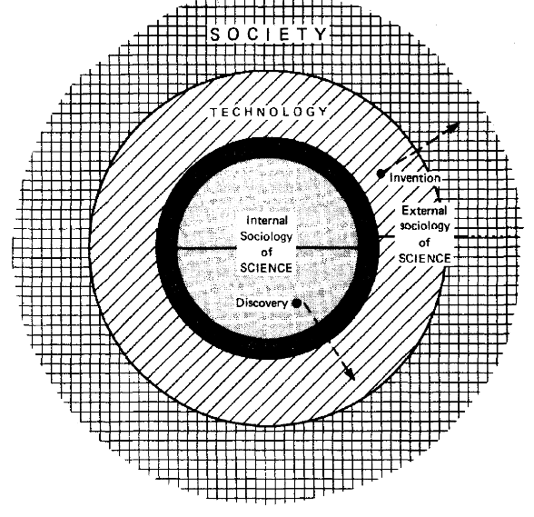
Internal and external sociology of science and technology
Ziman, J. M. (1987). An introduction to science studies: The philosophical and social aspects of science and technology. Cambridge University Press.

Slide 3
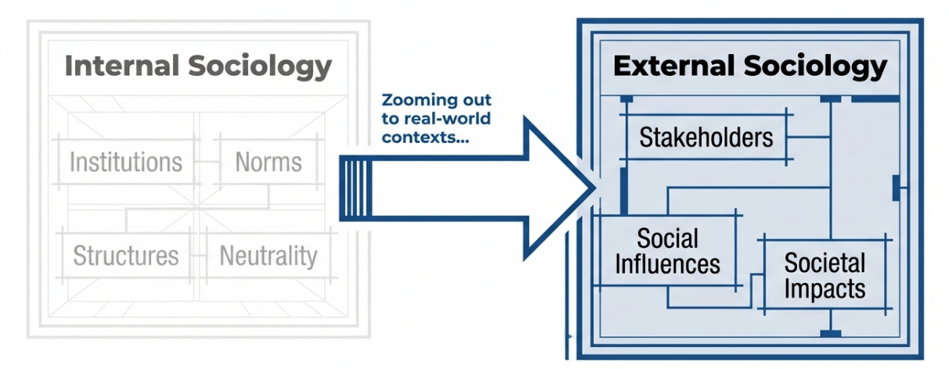

Slide 4
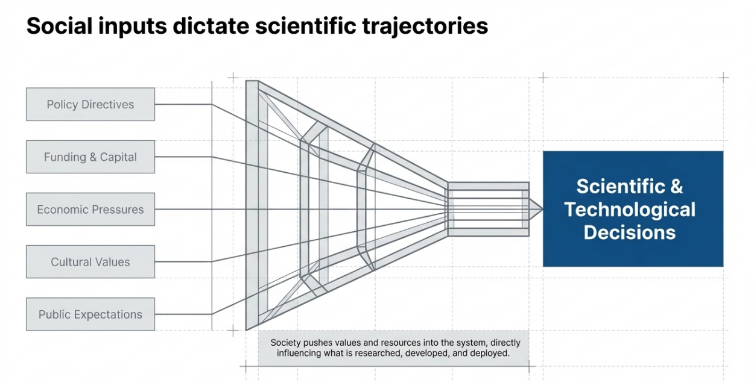

Slide 5
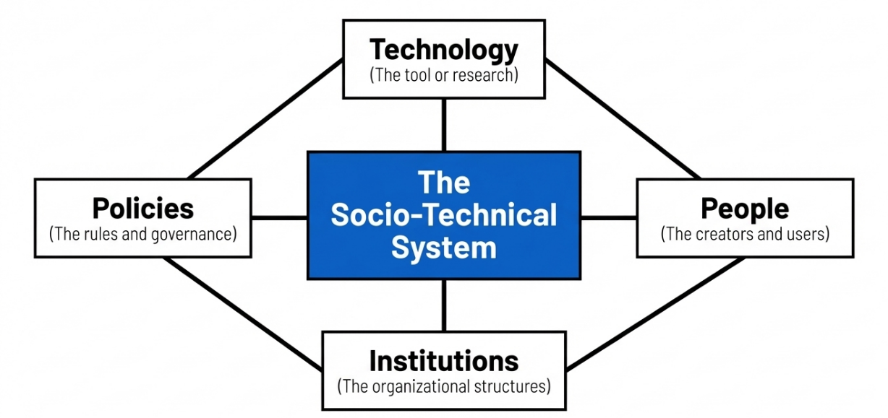
A socio-technical system recognises that science, technology and society are not independent.
They are shaped by interactions between people, institutions and policies.

Slide 6
A change in one component will influence other components:
Technology changes may alter how people behave, may require new policies or regulations
Policy / institutional changes may enable or restrict certain technologies, may influence how people use technology
Changes in people may drive demand for new technologies, may influence policy decisions

Slide 7
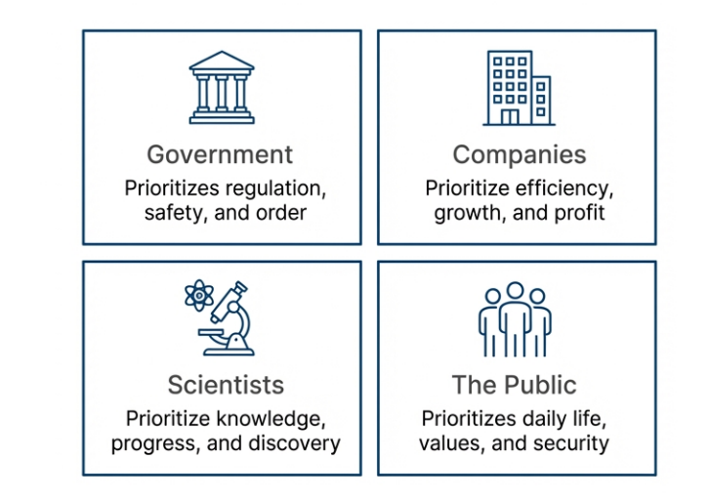
Stakeholders
Individuals or groups who are involved or affected by a science and technology issue
Different stakeholders have different interests

Slide 8
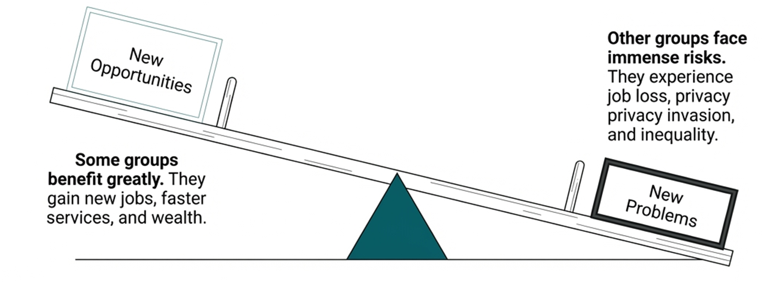
Trade-offs of technology in society- impacts are unequal

Slide 9
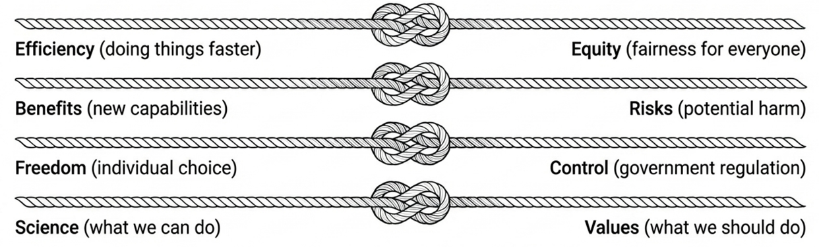
Competing interests or priorities among stakeholders may create controversy

Slide 10

Science, Technology and Sustainability
Sustainability
“Meeting the needs of the present without compromising the ability of future generations to meet their own needs.” (Brundtland Commission 1987)
Science, Technology and Innovation
https://sdgs.un.org/goals

Slide 11
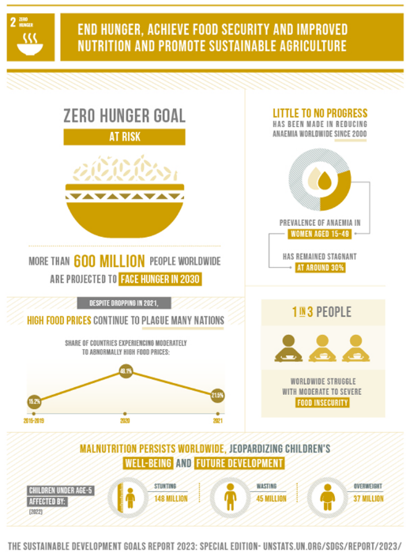
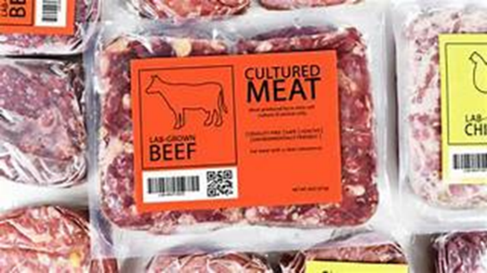
Case example 1: Cultured meat
Artificial meat or lab-grown meat, produced in vitro using tissue engineering techniques

Slide 12
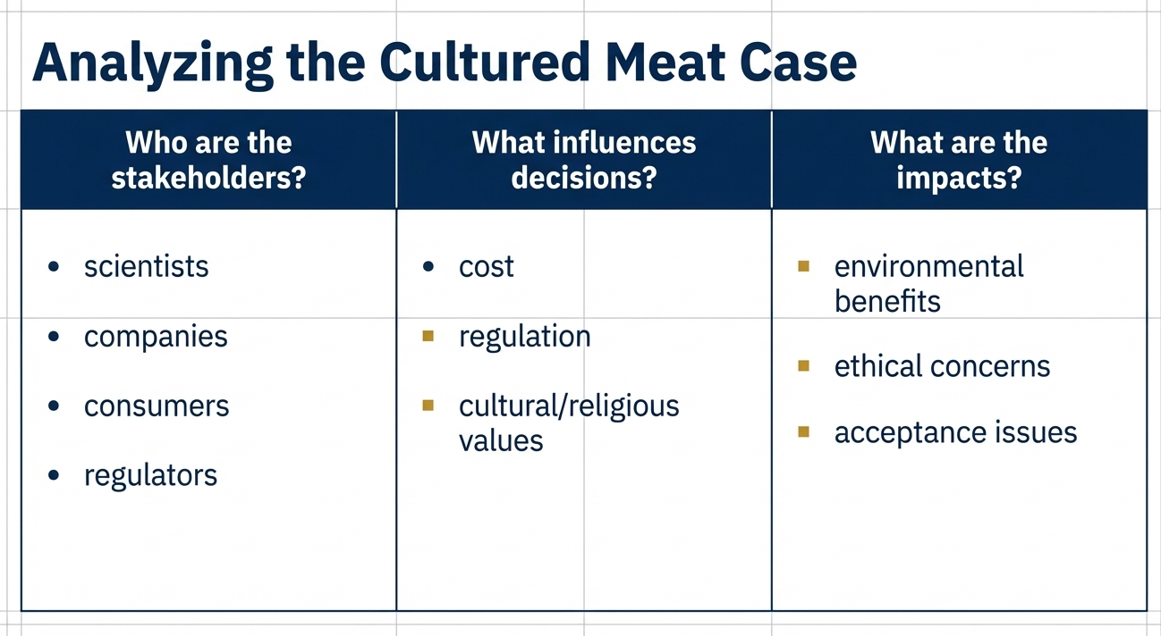

Slide 13
Class activity: Campus sustainability case example
Scenario: The university plans to allow only cars with campus stickers to enter the campus
Questions:
Who is most affected?
Will they support this plan?

